Slide 1
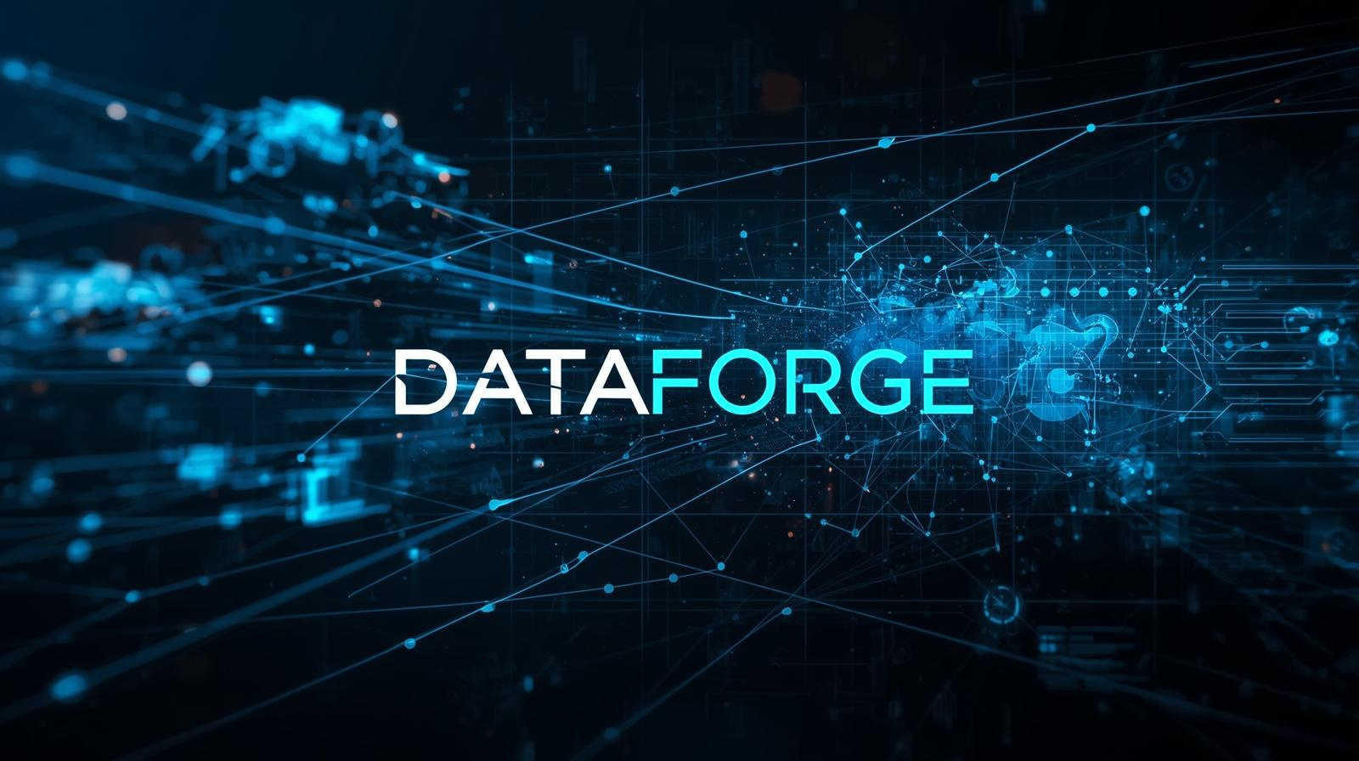

January 5, 2026
Unlocking Data's Potential
DataForge: The Future

Slide 2

Data Conversion Challenges
Manual data processing leads to increased complexity and delays, hindering the pace of AI innovation and development.

Slide 3

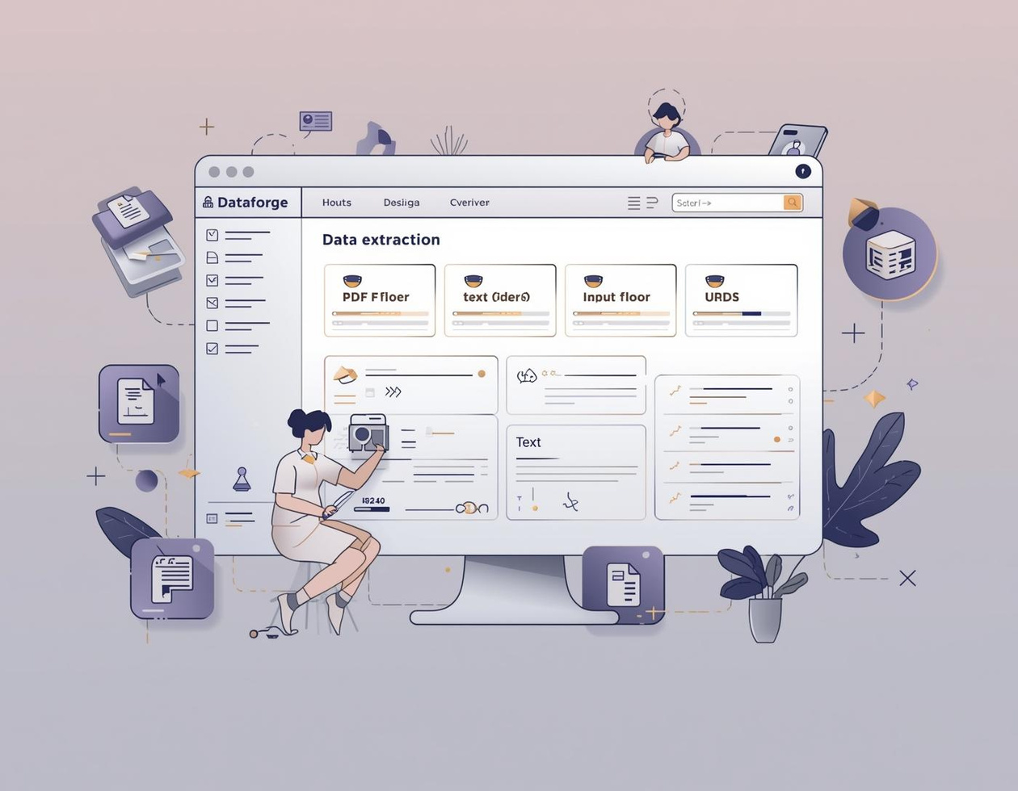
Introducing DataForge: Your Data Solution
Streamline Your Data Extraction Process
DataForge simplifies data conversion tasks for everyone.

Slide 4

DataForge Features
Key Capabilities of DataForge
Supports diverse input formats
Automated data extraction process
User-friendly interface for everyone
Seamless integration with AI tools

Slide 5
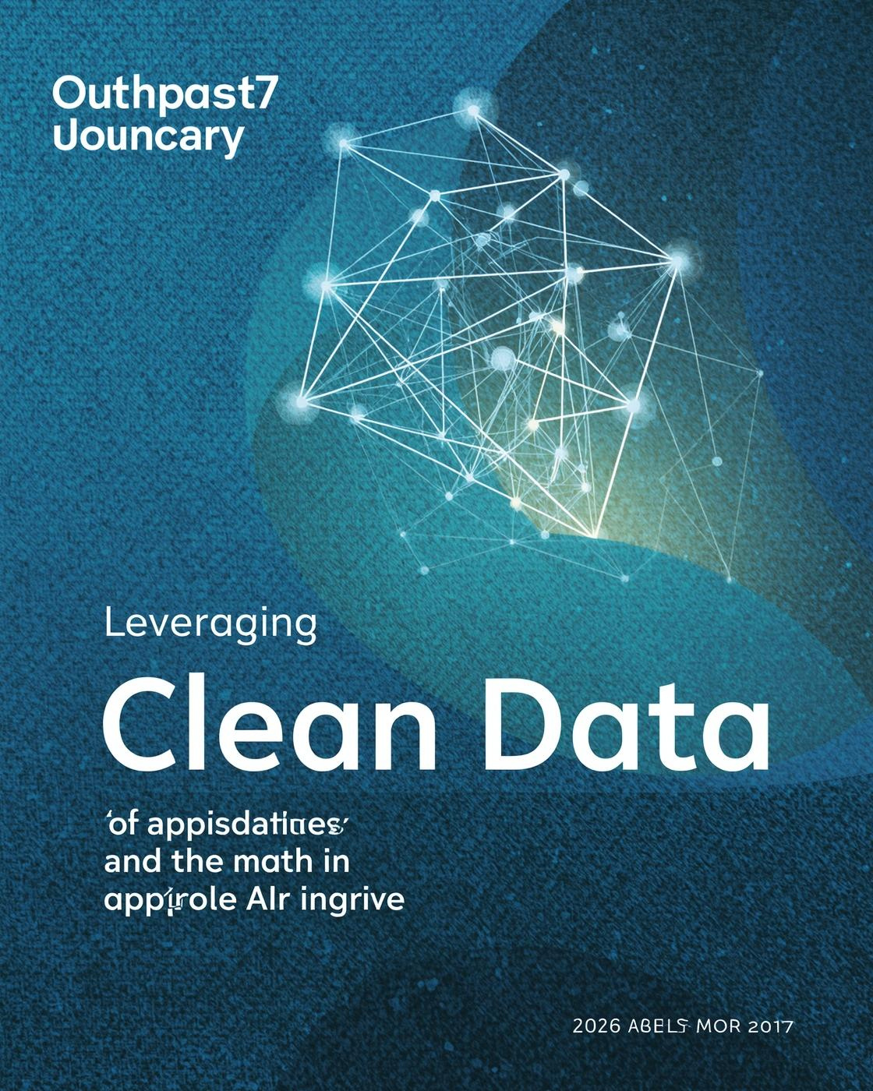
Leveraging processed data enables AI systems to operate efficiently, enhancing training speed and providing superior insights, ultimately driving innovation and productivity in various sectors.

